Slide 1
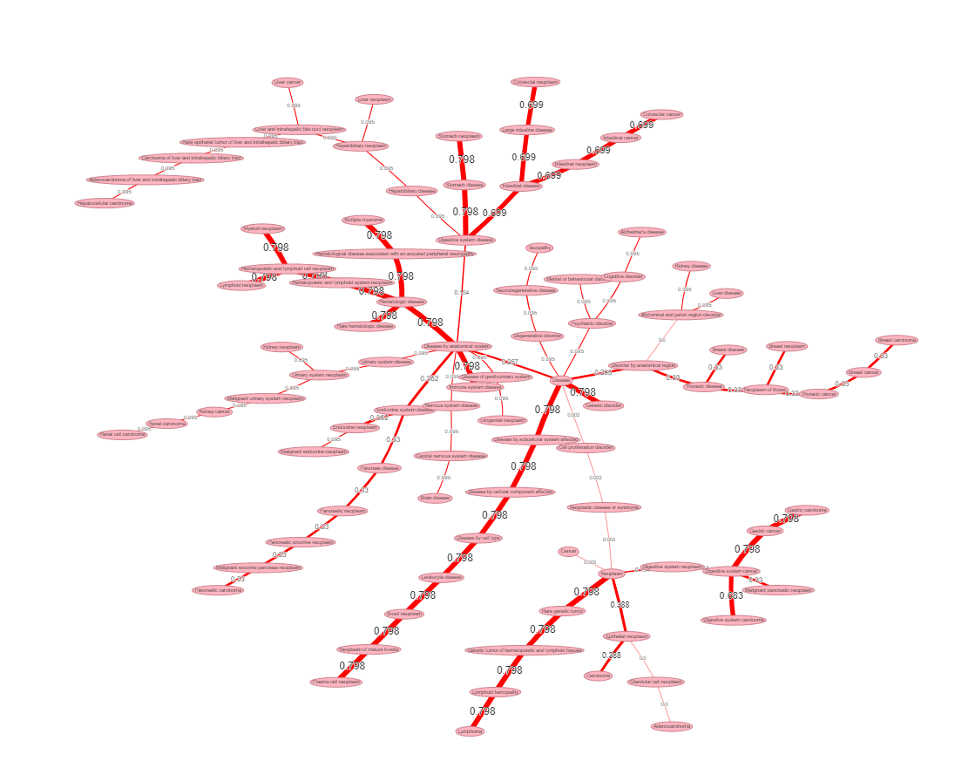
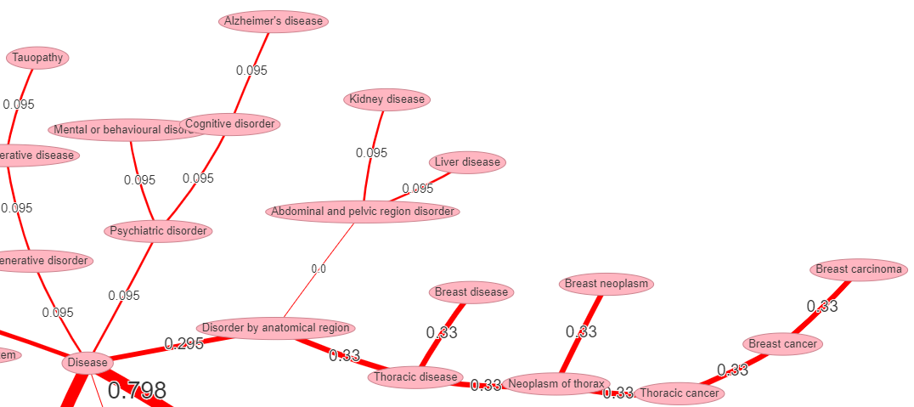
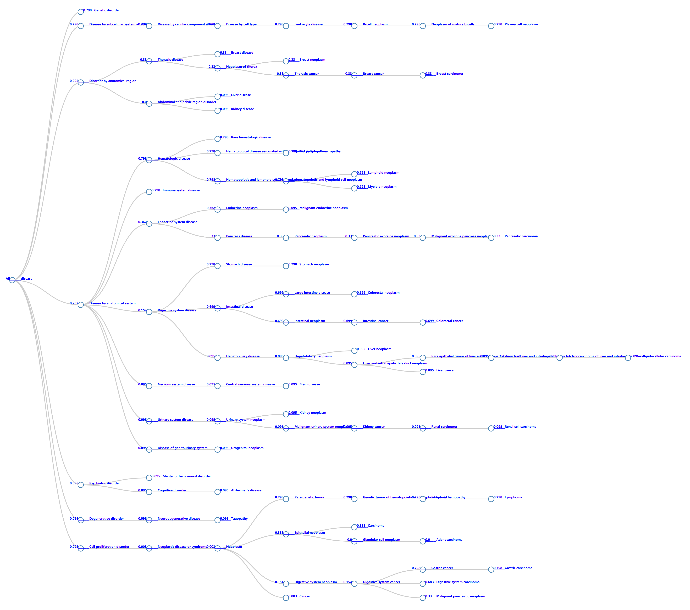
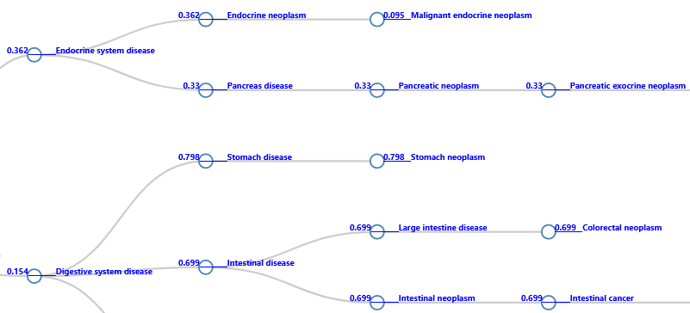
A
B
Supplemental_Fig_S1: The visualizations of disease-network (A) and -tree (B) for the piR-hsa-1282 dysregulation-disease phenotypes associations. The values by the lines and circle nodes are the confidence scores between the piRNA and the disease phenotypes.

