Slide 1
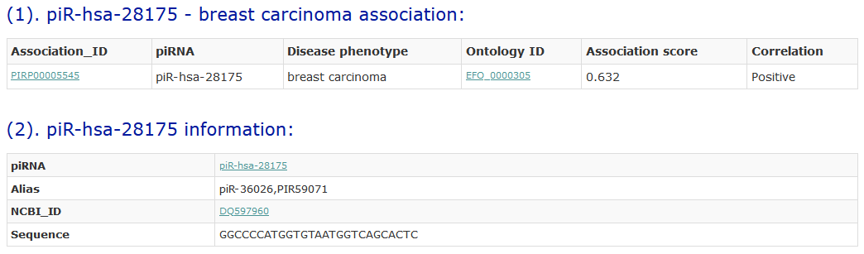
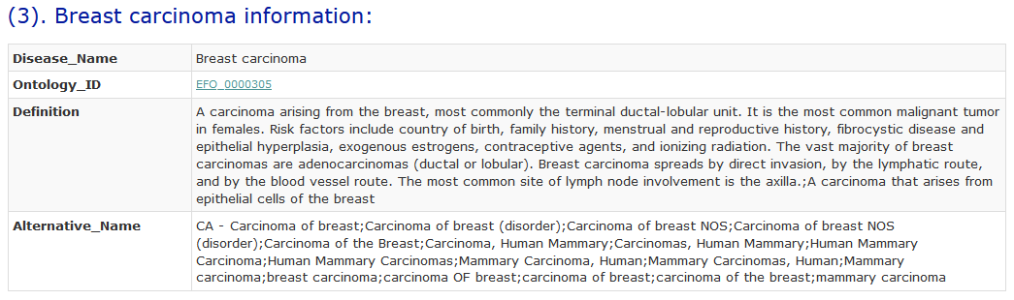
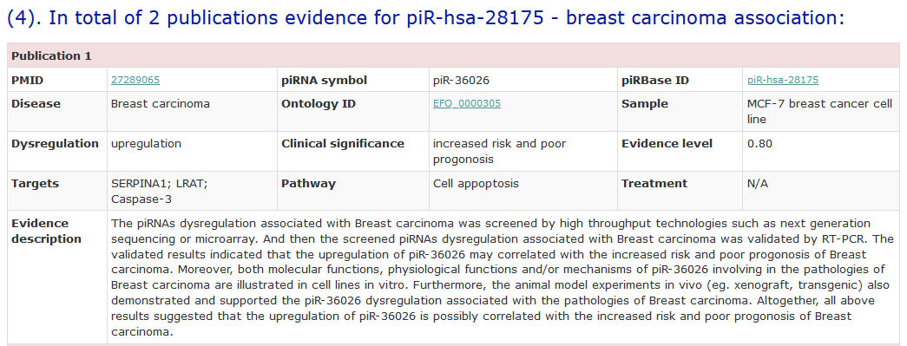
Supplemental_Fig_S2: The association information of the piRNA piR-hsa-28175 and breast carcinoma.

